Slide 1

Development of Machine Learning model for prediction of House prices.
Guided By:
Mrs. Trupti Joshi
Submitted By:
Akshay Patil (220943025003)
Aniket Jore (220943025011)
Hitesh Narang(220943025020)
Sahil Chavan (220943025033)
12/03/23
1

Slide 2
Introduction
It is challenging to accurately estimate a house's price. The project's overarching objective is to create a model that can predict the cost of a house in various areas of city. We intend to base this evaluation on available fundamental features that are taken into consideration when setting the price using different Machine Learning Algorithms.
Data used was collected from www.kaggle.com. The main goal of the analysis is to build an accurate and robust regression model to predict the outcome of House_Price. This project uses Random Forest, Decision Tree , Linear Regression , Polynomial Regression , Gradient-Boosting.
12/03/23
2

Slide 3
Outline
Introduction
Problem Statement
Project Methodology
Data Pre-Processing
Machine Learning Algorithms
Data Visualization & Representation
Conclusion
References
12/03/23
3

Slide 4
Project Methodology
Data Study and Data Cleaning
California housing
Data Transformation
Indexing and Vector-Assembler
Machine Learning Algorithm
Linear Regression
Data Visualization
Non-linear Regression
Plots Using Tableau
Fig: Project Flow diagram
12/03/23
4

Slide 5
Problem Statement
House price prediction based on the income population and other similar factors using ML model.
Distinguishing the price ranges based on geographical location
12/03/23
5

Slide 6
Data Pre-Processing
Missing values
Missing values in the type of “total_bedrooms_area” columns are dropped.
Checking of Data Types of Each Column
If any numeric column is being assigned as object(string) then we cast that value to the required data type as integer ,double etc.
String Indexer
12/03/23
6

Slide 7
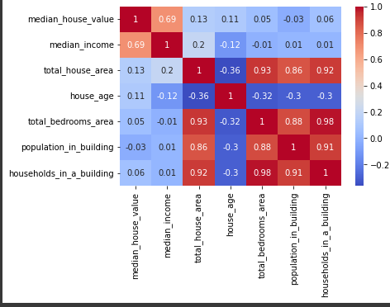
Correlation between independent variables using Heat Map

Slide 8
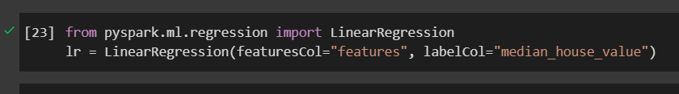
Machine Learning Algorithms
1.Linear Regression
Linear regression algorithm shows a linear relationship between a dependent (y) and one or more independent (y) variables, hence called as linear regression. Since linear regression shows the linear relationship, which means it finds how the value of the dependent variable is changing according to the value of the independent variable.
2.Random Forest
The Random Forest (RF) regressor is an ensembled learning method based on multiple decision trees.
By combining the Bootstrap aggregating and random space method, RF overcomes the drawbacks of individual decision tree.
RF is widely used in industry because it can classify high dimensional data in short time with good performance and it has low sensitivity to outliers in the training data.
8

Slide 9
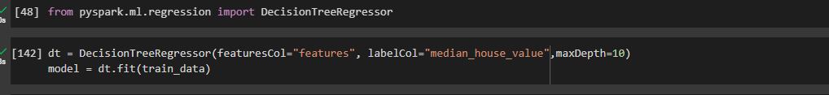
3.Decision Tree
A Decision Tree is a simple representation for classifying examples. It is a Supervised Machine Learning where the data is continuously split according to a certain parameter.
4.Polynomial Regression
Polynomial Regression is a regression algorithm that models the relationship between a dependent(y) and independent variable(x) as nth degree polynomial
12/03/23
9

Slide 10
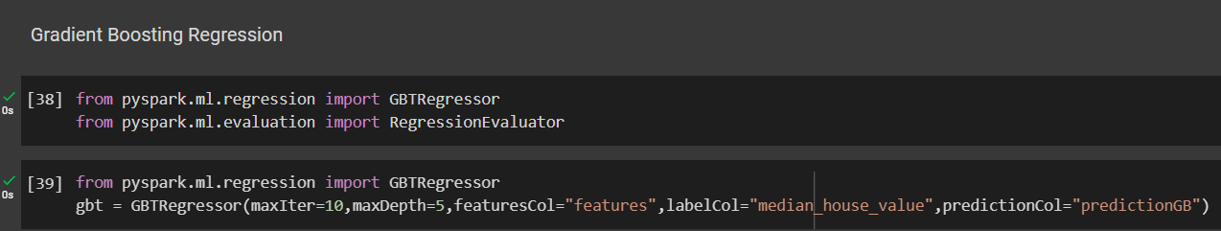
5.Gradient Boosting
Gradient boosting is one of the variants of ensemble methods where you create multiple weak models and combine them to get better performance as a whole.
12/03/23
10

Slide 11
ACCURACY OBTAINED BY DIFFERENT ALGORITHMS
ALGORITHM USED FOR MODEL | R2 SCORE OBTAINED
Linear Regression | 0.640
Random Forest Regressor | 0.651
Decision Tree Regressor | 0.71
Polynomial Regression | 0.642
Gradient Boosting | 0.729
12/03/23
11

Slide 12
Data Visualization
In the first graph, which is a side-by-side bar chart, the average property value based on proximity to the ocean and the average income of the homeowners in the relevant category are both displayed.
The second graph shows the number of bedrooms the home has available in relation to various ocean proximity categories.
The information concerning the relationship between income and home value is shown in the third scatter plot graph.
From the following graph (solid map), we can deduce the lowest and maximum value of a house in various ocean proximity ranges.
A bubble chart is used to show how many homes are available in each category.
12/03/23

Slide 13
Conclusion
In conclusion, predicting house prices based on features such as ocean proximity, number of bedrooms, area, population, and median income of people can be an effective way to estimate the value of a property. The features mentioned in the analysis are important factors that can affect the demand and supply of housing in a given area.
Ocean proximity can be a significant predictor of house prices, as houses closer to the ocean tend to be in higher demand and can command higher prices. The number of bedrooms and area of a property can also impact its value, as larger properties and those with more bedrooms tend to be more desirable for families and can command higher prices.
Overall, the combination of these features can provide a robust basis for predicting house prices. By leveraging machine learning algorithms, it is possible to create accurate models that take into account these important features and provide reliable estimates of the value of a property.
12/03/23
13

Slide 14
Thank you!!!
14

